Slide 1

Facial emotion recognition

Slide 2

Agenda
Intro
Project
Product
Algorithms
Presentation
Conclution

Slide 3
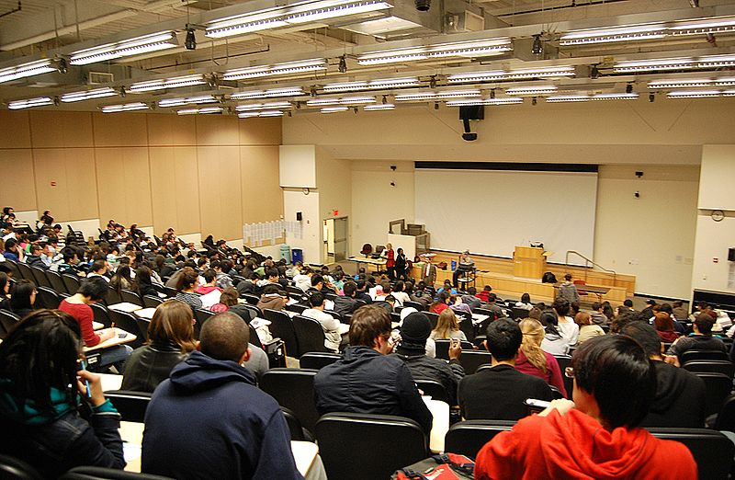

Corona
Notes:
Timo:
Hier können wir die Story bzgl. veränderter Situation erzählen.

Slide 4
Solution? Our Project!
Track your students and see where they are falling asleep.

Slide 5
Product
Add screenshot of final GUI

Slide 6
Algorithms Start
Here we should give an overview of our algorithms. Also we should mention that we implemented CNN because its normaly the common solution for this problem, but wanted to have some other algorithms to compare with.

Slide 7
KNN

Slide 8
Adaboost

Slide 9
SVM

Slide 10
CNN

Slide 11
Presentation
Here we should switch to Jonas Laptop and show our tool.

Slide 12
Conclusion
Here we can wrap up the project.
What did we acchieve, what was good/bad
IMO at the beginning we were a little bit lost/unstructured but managed to implement 4 different algortihms for the same problem.
At the end, we can show our idea of realtime emotion recognition

Slide 13
Quellen Bilder:
All pictures are free for non-commercial use.
Deckblatt: https://commons.wikimedia.org/wiki/File:Emotion_Recognition_Deficit.jpg
Agenda:
https://commons.wikimedia.org/wiki/File:Hey_Machine_Learning_Logo.png
Intro:
https://commons.wikimedia.org/wiki/File:5th_Floor_Lecture_Hall.jpg
https://www.pikist.com/free-photo-sobwr
Project:
Product:

